Slide 1

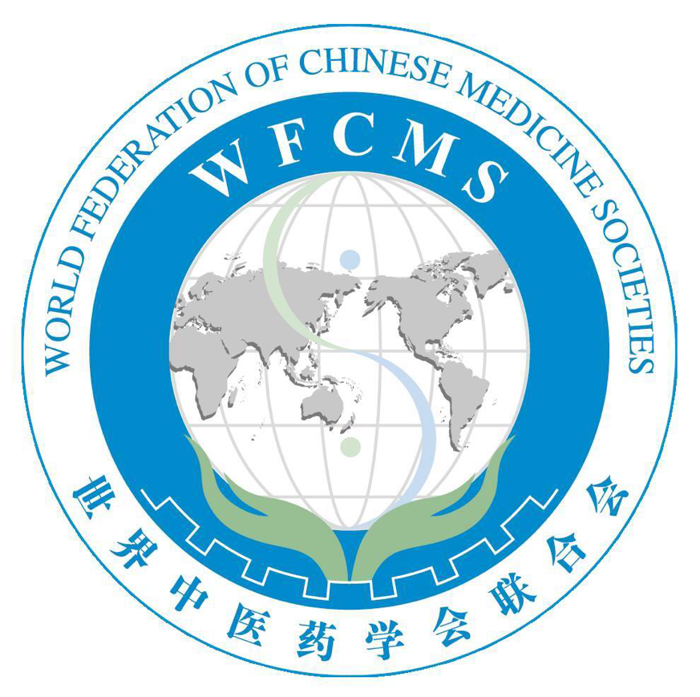

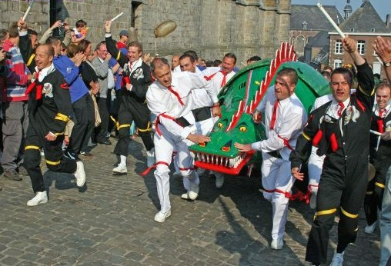
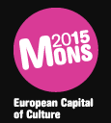
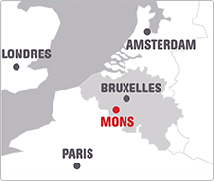
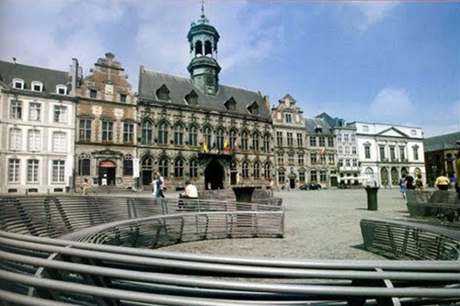
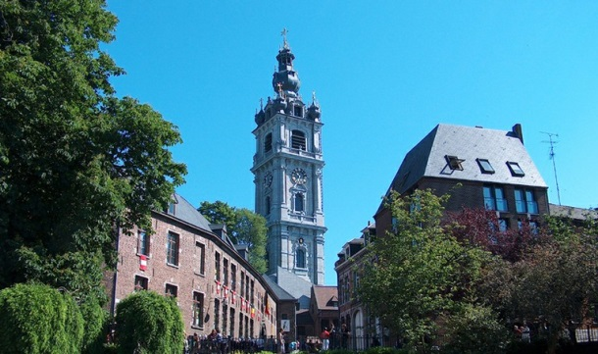
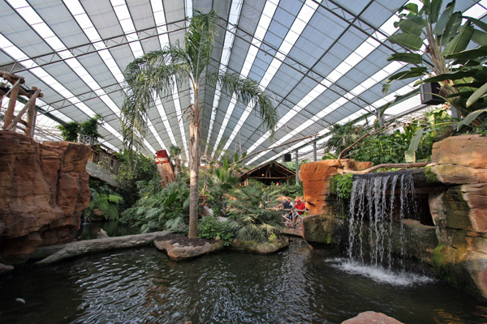
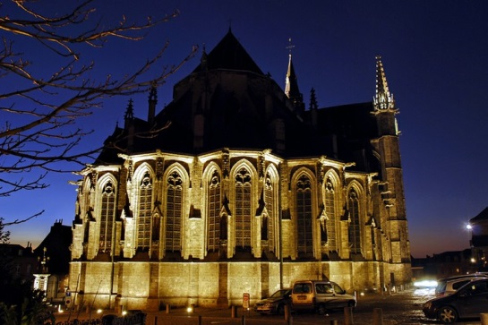



Joint meeting of the GPTCM Research Association, the TCM Specialty Committee of the WFCMS and the TCM Pharmaceutical Analysis Specialty Committee of the WFCMS
July 2015, Mons, Belgium
Organizing committee: De-An Guo, Rudolf Bauer, Qihe Xu , Peter Hylands, Tai-Ping Fan, Hai-Xue Kuang
Local organizing committee: Pierre Duez , Blankert Bertrand, Nachtergael Amandine (UMONS), Stévigny Caroline, Bunel Valérian (ULB)
Invitation to the Joint meeting of the GPTCM Research Association, the TCM Specialty Committee of the WFCMS and the TCM Pharmaceutical Analysis Specialty Committee of the WFCMS
The Good Practice in Traditional Chinese Medicine Research Association (GP-TCM RA) invites all scientists from academia and industries dealing with traditional Chinese medicine, natural medicine, medicinal plants and acupuncture to attend this meeting.
The scientific meeting will be held in University of Mons, located in Mons a city in the south of Belgium, 2-3 h from Paris, London and Amsterdam. Mons own three works of art that UNESCO has listed as World Heritage sites and has been chosen to be the European Capital of Culture in 2015. During this year, the city will be marked by a plenty of festivals, joint projects and surprises.
Scientific topics
Quality control and standardization | Liu AIping
Pharmacology and toxicology | Duez Pierre, Fan Qu
Clinical and in vivo studies | Chan Kelvin
Acupuncture | Robinson Nicholas
Regulatory affairs | Fan Tai-Ping
etc.
Call for abstract
The abstract should be structured with four subheadings : (i) Introduction/Aim of the study, (ii) Material and methods, (iii) results and (iv) Discussion and conclusions. The text should not exceed 250 words.

