Slide 1
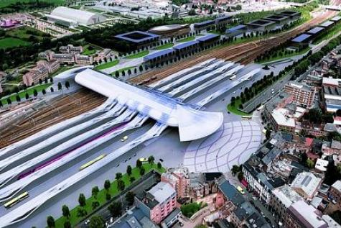
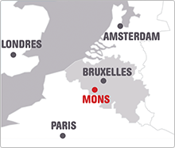
Joint meeting of the GPTCM Research Association, the TCM Specialty Committee of the WFCMS and the TCM Pharmaceutical Analysis Specialty Committee of the WFCMS 13th-15th July 2015, Mons, Belgium
First Announcement
Invitation to the Joint meeting of the GPTCM Research Association, the TCM Specialty Committee of the WFCMS and the TCM Pharmaceutical Analysis Specialty Committee of the WFCMS
The Good Practice in Traditional Chinese Medicine Research Association (GP-TCM RA) invites all scientists from academia, industries, and other fields, dealing with traditional Chinese medicine, natural medicine, medicinal plants and acupuncture research to attend this meeting.
The scientific meeting will be held in University of Mons, located in Mons, a city in the south of Belgium, 1.5h by train from Brussels and 2-3 h by train from Paris, London and Amsterdam. Mons owns three works of art that UNESCO has listed as World Heritage sites and has been chosen to be the European Capital of Culture in 2015. During this year, the city will be marked by a plenty of festivals, joint projects and surprises.

Slide 2
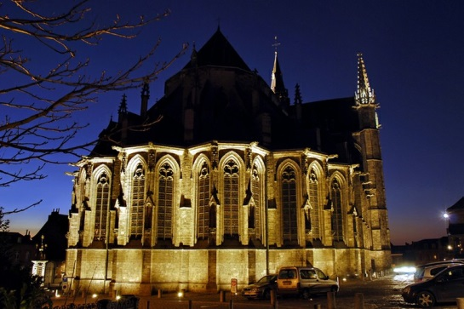
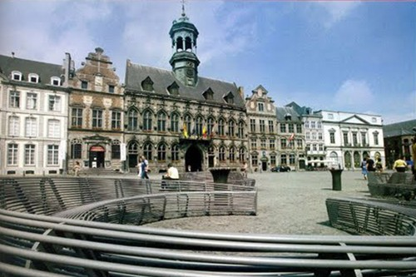
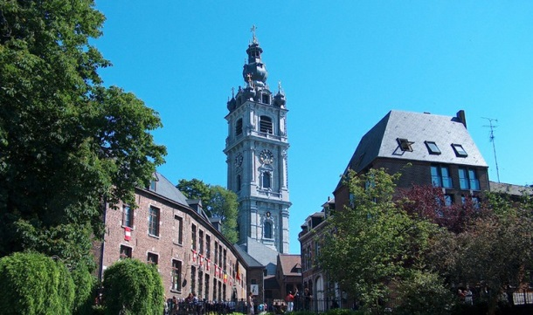
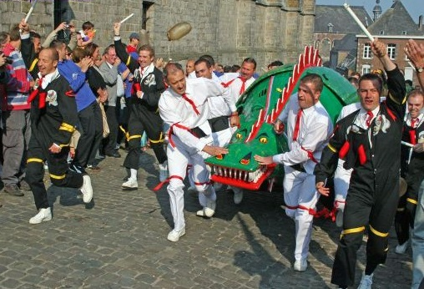
Joint meeting of the GPTCM Research Association, the TCM Specialty Committee of the WFCMS and the TCM Pharmaceutical Analysis Specialty Committee of the WFCMS 13th-15th July 2015, Mons, Belgium
First Announcement
Organizing committee: De-An Guo, Rudolf Bauer, Qihe Xu , Peter Hylands, Tai-Ping Fan, Hai-Xue Kuang
Local organizing committee: Pierre Duez , Blankert Bertrand, Nachtergael Amandine (UMONS), Stévigny Caroline, Bunel Valérian (ULB)
Scientific topics Chair
Quality control and standardization Prof. Kelvin Chan and Prof. Yuan-Shiun Chang
Pharmacology and toxicology Prof. Pierre Duez and Dr. Fan Qu
Clinical and in vivo studies Prof. Aiping Lu
Acupuncture Prof. Nicola Robinson and Prof. Jian-ping Liu
Regulatory affairs Dr. Tai-Ping Fan and Prof. Wei-Dong Zhang
etc.
Call for abstract The abstract should be structured with four subheadings : (i) Introduction/Aim of the study, (ii) Material and methods, (iii) results and (iv) Discussion and conclusions. The text should not exceed 250 words.

